Slide 1




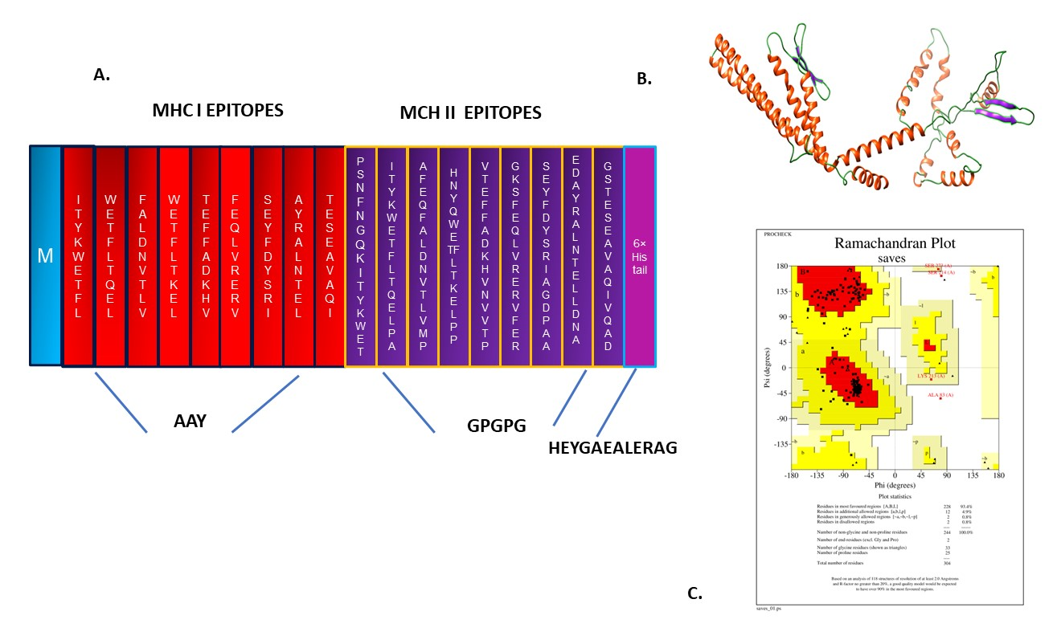
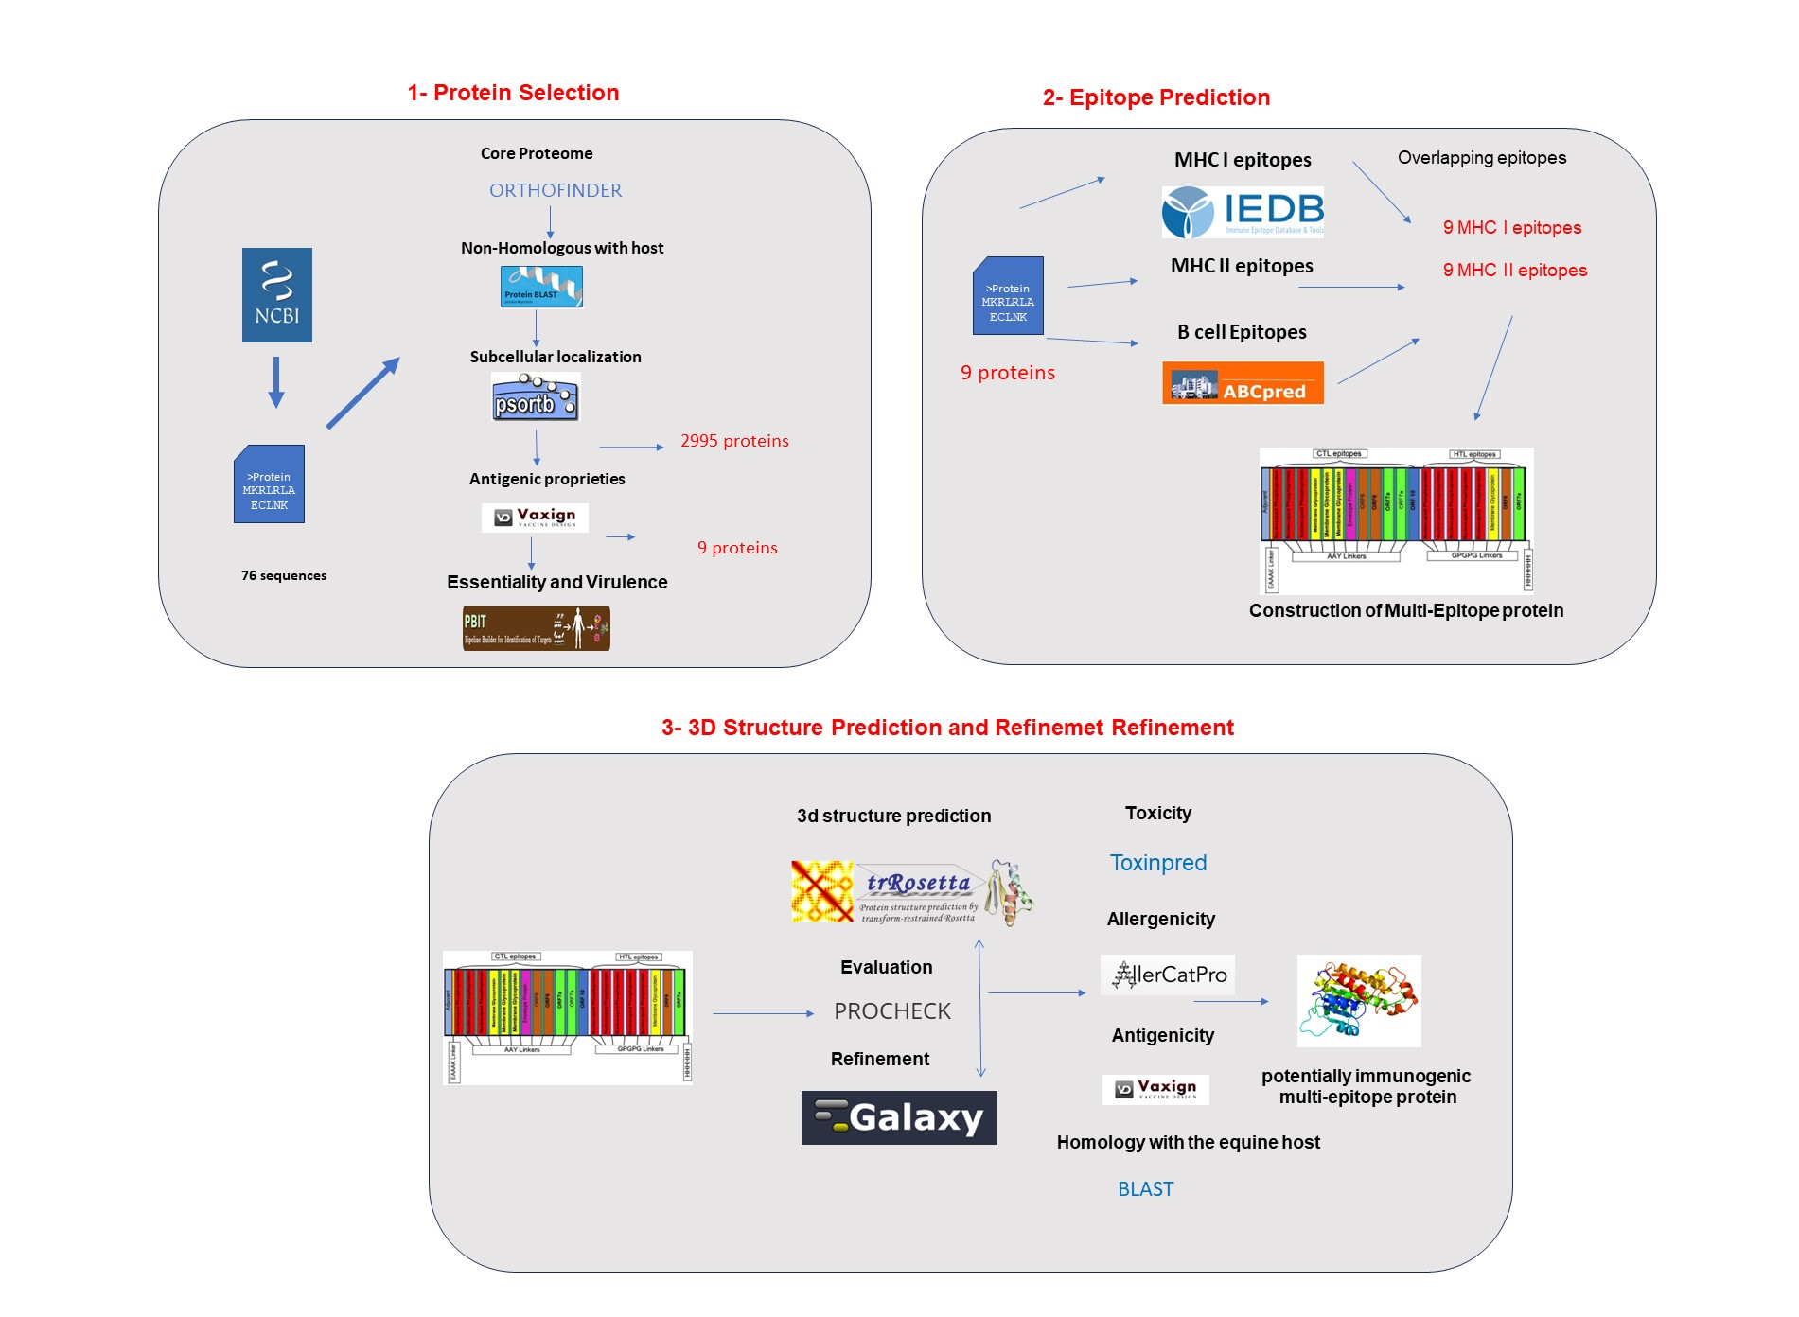
XXIII EXPOPPGIm
Reunião Anual do Programa de Pós-Graduação em Imunologia da UFBA
DESIGNING A NOVEL MULTI-EPITOPE IMMUNOGENIC PROTEIN AGAINST RHODOCOCCUS EQUI INFECTIONS
Rodrigo Alex Henríquez Arancibia, Roberto Meyer, Nubia Seyffert, Sandeep Tiwari, Ricardo Dias Portela, Thiago Luiz de Paula Castro
Laboratory of Immunology and Biology (LABIMUNO), Institute of Health Science (ICS), Federal University of Bahia (UFBA), Bahia, Brazil
INTRODUCTION
RESULTS
Rhodococcus equi is an aerobic, opportunistic, and saprophytic bacterium. This microorganism is responsible for causing severe pyogranulomatous bronchopneumonia in equine foals between 1 and 6 months old. This infection has high rates of mortality and morbidity, significantly impacting equine farming both in Brazil and globally. Several vaccines have been developed in recent decades, but none have shown satisfactory results for large-scale use. The reverse vaccinology strategy has proven to be an effective and secure method for the design of multi-epitope proteins. We seek to design an immunogenic multi-epitope protein with potential application in vaccinal formulations against R. equi infections.
We identified 2995 proteins in the core proteome of R. equi and non-host homologs, of which nine specific proteins were chosen for epitope prediction. These consisted of a multi-epitope protein with 9 MHC I epitopes and 9 MHC II epitopes connected by appropriate linkers (Fig 2A). According to the Ramachandran plot, the multi-epitope protein presents a stable structure with 33.44 kDa and 93.4% of the amino acid residues in the most favorable regions (Fig 2B and 2C). Only 0.8% of the amino acid residues were placed in disallowed regions in the predicted model. The designed protein was predicted to be immunogenic, non-toxic, non-allergenic, and non-homologous to the host proteins.
METHODOLOGY
A
C
This work was developed using in silico approaches based on comparative genomics, subtractive genomics, and immunoinformatics. First, we retrieved total protein sequences from 76 R. equi genomes publicly available in the NCBI database. An analysis was conducted to define the core proteome of R. equi using Orthofinder, and Blastp was used to find the proteins non-homologous to the host Equus caballus. The target proteins were selected according to their subcellular localization (PSORTb), antigenicity, (Vaxign), essentiality, and virulence properties. Next, an analysis was performed to predict epitope binding affinity to MHC I, MHC II, and B cells, using the IEDB database and ABCpred. Overlapping epitopes with high binding affinities were combined with small peptide linkers to construct one chimeric protein. Then, we predicted, evaluated and refined the tertiary structure of this multi-epitope protein using trRosetta. Toxicity, allergenicity, antigenicity, and homology with proteins in the equine host were also predicted for the chimera.
B
Fig 2 . (A) Multi-epitope protein construct designed in this work, containing one methionine (M), 9 MHCI epitopes, 9 MHC II epitopes, 6 histidines purification tag, and respective peptide linkers. Sequence length is 304 amino acid residues. (B) Tree-dimensional structure modelling of the refined multi-epitope protein obtained with trRosetta. (C) The Ramachandran plot for the model after refinement.
CONCLUSION
Our in silico workflow enabled the design of a potentially immunogenic multi-epitope protein combining high-affinity epitopes retrieved from natural proteins predicted in R. equi sequenced strains and not present in the equine host. Next, we will proceed to additional analyses, such as evaluating the stability of the interaction between the multi-epitope protein and the toll-like receptor and the prospection of potential adjuvants for vaccinal formulations based on this protein. Finally, the recombinant protein will be produced and evaluated regarding its potential use to control rhodococcosis in herds.
Fig1. The diagram of the pipeline developed and used in this work to desing one multi-epitope protein with immunogenic potential against R. equi infections.
Support
We acknowledge support from CAPES and CNPq.

